Slide 1

Team 10: Instacart Product Recommendation System and Analysis using Azure Cosmos DB
1. Shashank Dongre - NUID 002747740
2. Ashwini Khedkar - NUID 002738717
3. Keerthanaa Kannan - NUID 001593845
4. Samradni Pathari - NUID 002655149

Slide 2
OBJECTIVES
Representing orders and prior orders as a document database to improve recommendation accuracy.
Using a document-graph hybrid model to analyze and visualize relationships between customers and the products they ordered, visualize the location of products that are more likely to be reordered.
Implementing a graph database model to visualize the relationships between customers, products, and product availability locations.
Analyzing the details, frequency, and likelihood of the most frequently ordered products.

Slide 3
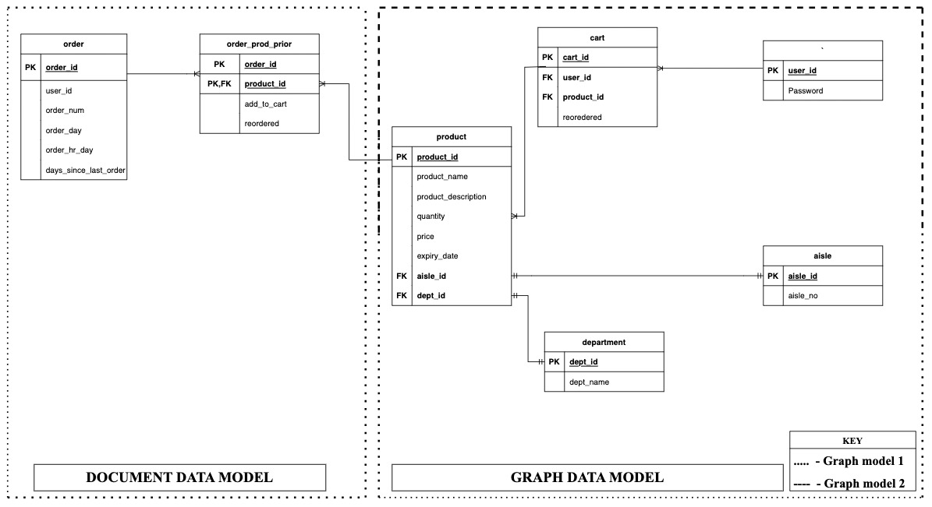
ER DIAGRAM

Slide 4
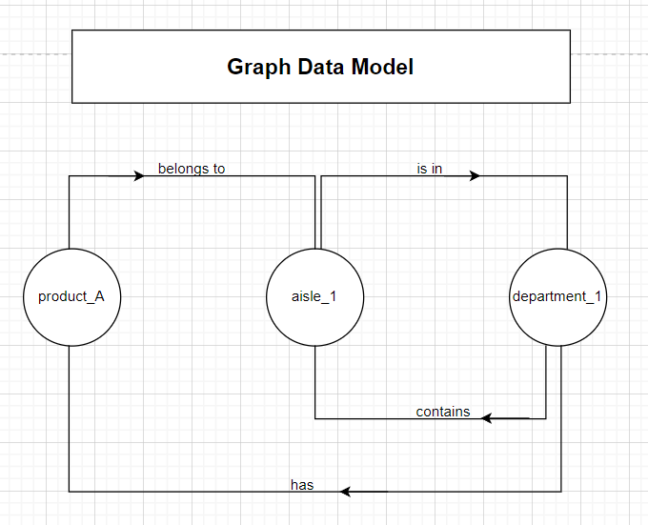
GRAPH MODEL

Slide 5
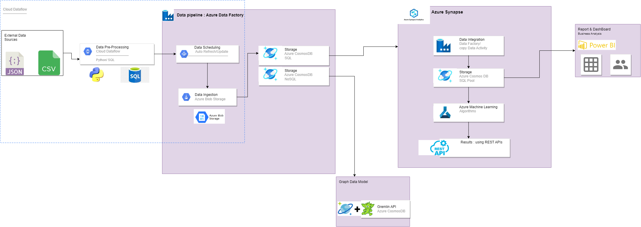
ARCHITECTURE DIAGRAM

Slide 6
INTEGRATION AND IMPLEMENTATION
Implementation of document data model using SQL: Open JSON
Implementation of document data model using SQL: Using Recursive processing (a single table containing node and edge data) OR
Using the MATCH function to match the Node table(regular data) and Edge Table (relationships)
Integration of Document and Graph Data Models: Using Azure Synapse (exploring other options as well)
STEP 1
STEP 1
STEP 2
STEP 2
STEP 3
STEP 3

Slide 7
THANK
YOU

